Slide 1
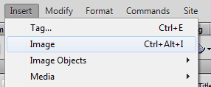
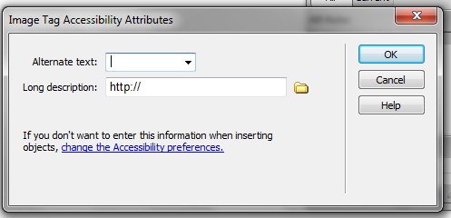
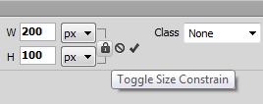
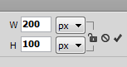
Web Authoring (Ski Resort Task)
Task 4 – Importing Content
Insert the appropriate images into the cells in the Table 1. Include alternative Text for each image. LogoA HeaderB Ski_C Promotion LearnE ShoppingF PackagesG VillageH AccommodationI SnowmobilesJ TicketsK BookingL
Resize the following images so the width is 200PX wide. Maintain the aspect ratio. VillageH SnowmobilesJ
A | B
C |  | D
 |  | E | F
 |  | G | H
 |  | I | J
 |  | K | L
Aspect ratio on
Aspect ratio off

